Slide 1

DBMS PROJECT (BCA 481) 2024
Eco Harbour
Navigating Tomorrow's Ocean Today
Team Members:
Gaurav Jain - 2241129
Greeshma Girish C - 2241130
Navaneeth Kishore C.H - 2241144
Under the supervision of Dr.Sreeja C.S.
(Assistant Professor)
MISSION
CHRIST is a nurturing ground for an individual’s holistic development to make effective contribution to the society in a dynamic environment
VISION
Excellence and Service
CORE VALUES
Faith in God | Moral Uprightness Love of Fellow Beings
Social Responsibility | Pursuit of Excellence

Slide 2
Agenda
CHRIST
Deemed to be University
Problem Statement
Title
Abstract
Introduction
Existing Systems
Limitations
Modules
Project Flow Diagram
Entity Relationship Diagram
Database in MongoDB
User Interface of Application
References

Slide 3

Title: Eco-Harbour
CHRIST
Deemed to be University
Eco-Harbour suggests a place where environmental consciousness meets the concept of a safe port or harbor, indicating safety and preservation for marine life

Slide 4
Abstract
CHRIST
Deemed to be University
Eco-Harbour is designed to monitor and manage fishing activities .
Promote sustainability and minimizing environmental impact.
It encompasses data on catches, regulations, environmental factors sustainability metrics.

Slide 5
Introduction
Eco Harbour emerges as a dynamic platform, for connecting fishing enthusiasts to ensure responsible fishing practices for the long-term preservation of marine resources.
The platform’s major goal is to preserve the oceans and marine biodiversity for future generations.
Eco Harbour aligns with key Sustainable Development Goals (SDGs), addressing SDG 14 (Life Below Water) by advocating for the preservation of marine ecosystems and its commitment to sustainable fishing practices.

Slide 6
Existing Softwares
CHRIST
Deemed to be University
FishTrack: This app suggest fishing spots and also allows users to record catches and share locations with fellow anglers.
FishAngler: It helps users to find fishing spots, share catches, and connect with other fishermen.
GoFish: This app combines fishing location recommendations with a social media platform so that users can share their experiences with a community of enthusiasts.

Slide 7
Limitations
CHRIST
Deemed to be University
Lack of Data accuracy and Relevance: Many of these apps rely on user-reported data, which can be inaccurate and leads to unreliable recommendation .
Lack of Sustainability Focus: These apps primarily focus on maximizing catch rates, which can potentially contribute to overfishing and unsustainable practices.

Slide 8
Problem Statement
CHRIST
Deemed to be University
Overfishing : Many fish stocks are being depleted at unsustainable rates .
Limited Knowledge : Focus on popular fish species,neglects lesser-known alternatives.

Slide 9
Modules
CHRIST
Deemed to be University
Login Module : Provides secure access.
Admin Module : Manage users .
Fish Detection : Identify fish species in specific locations.
Availability Trends : Find suitable harbours for desired catches.
Education and Outreach : Share insights on community page.
History and Records : Track catch trends over time.
Reward System : Encourage sustainable fishing practices with rewards.

Slide 10
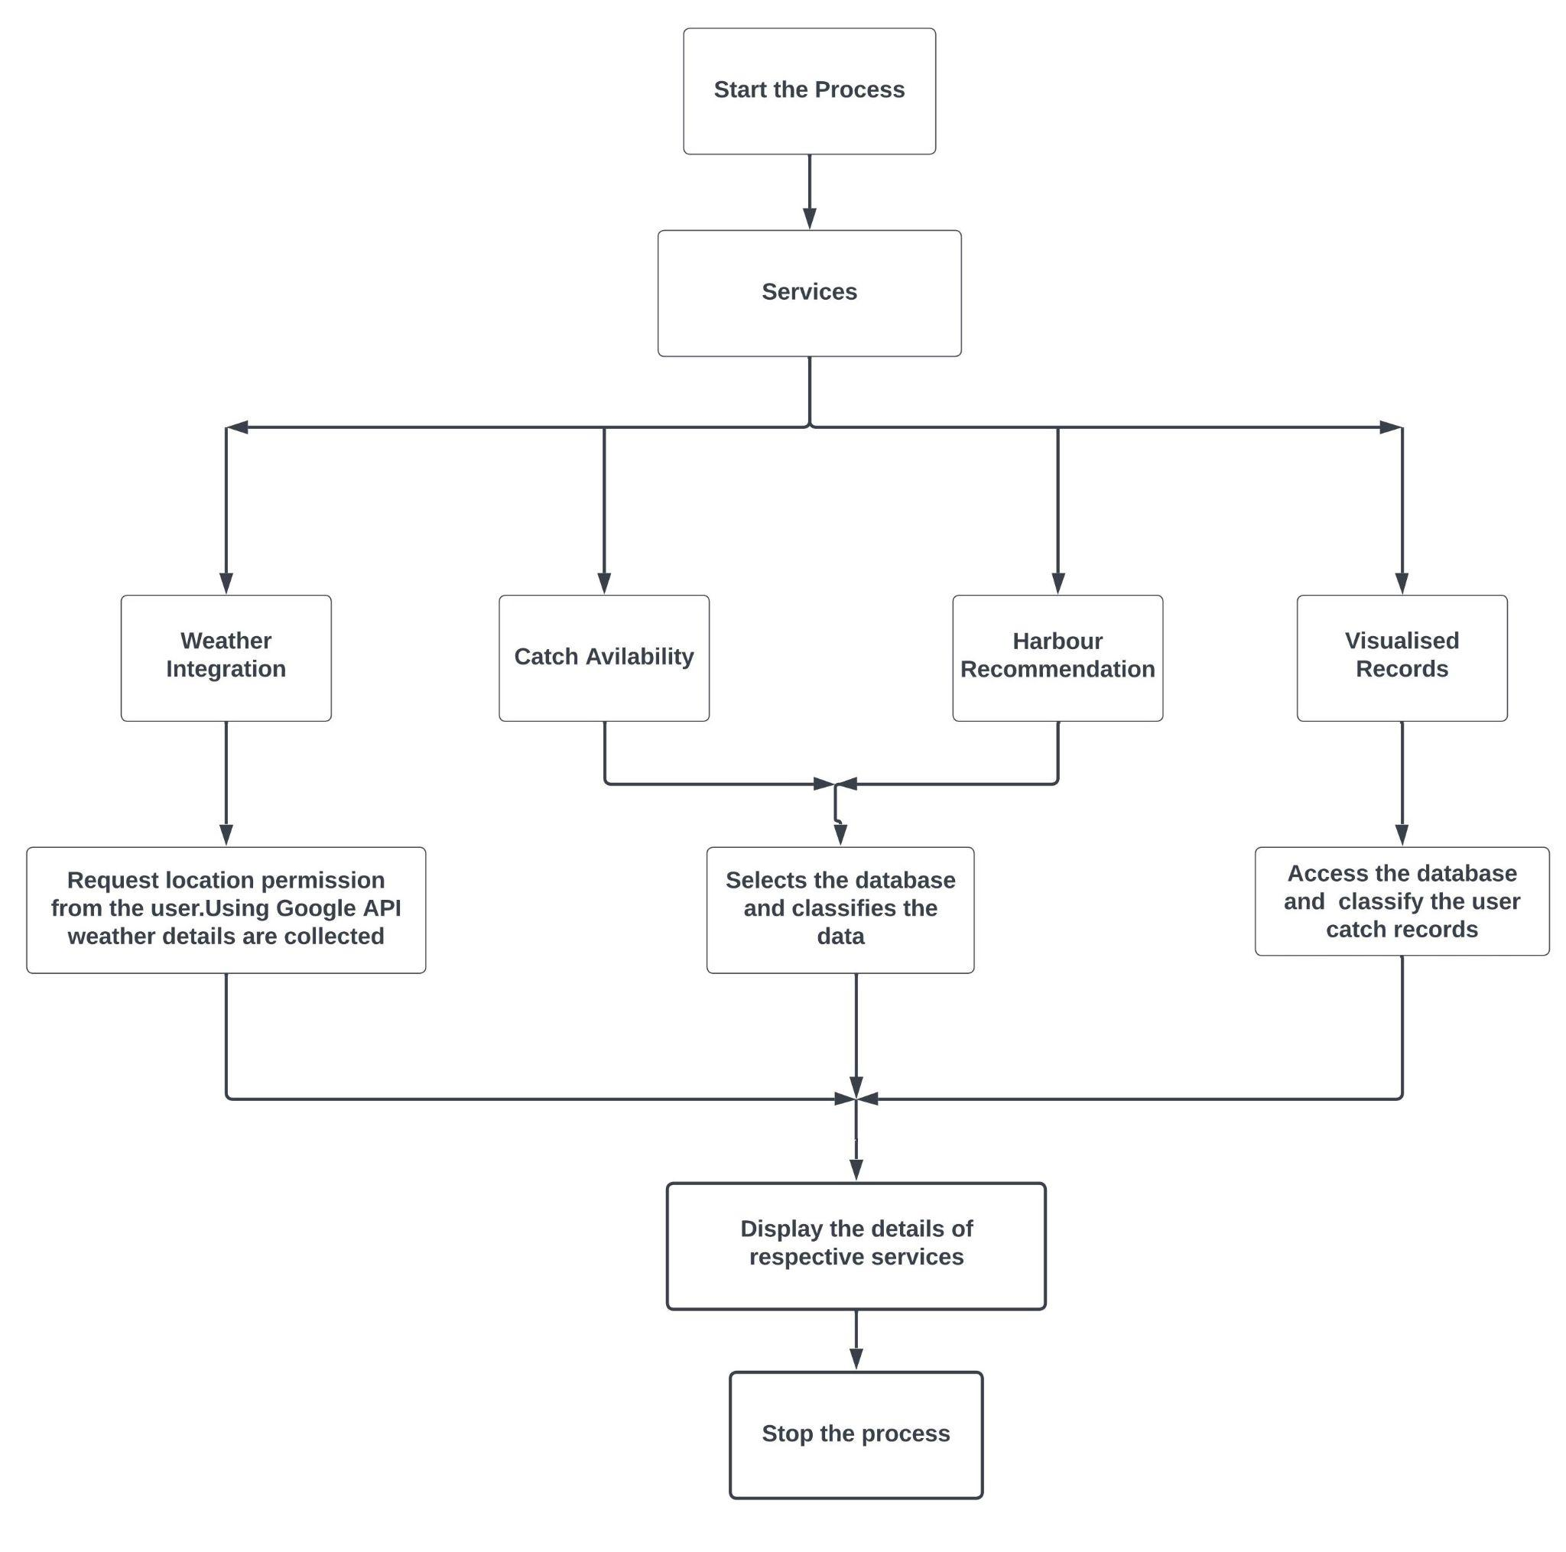
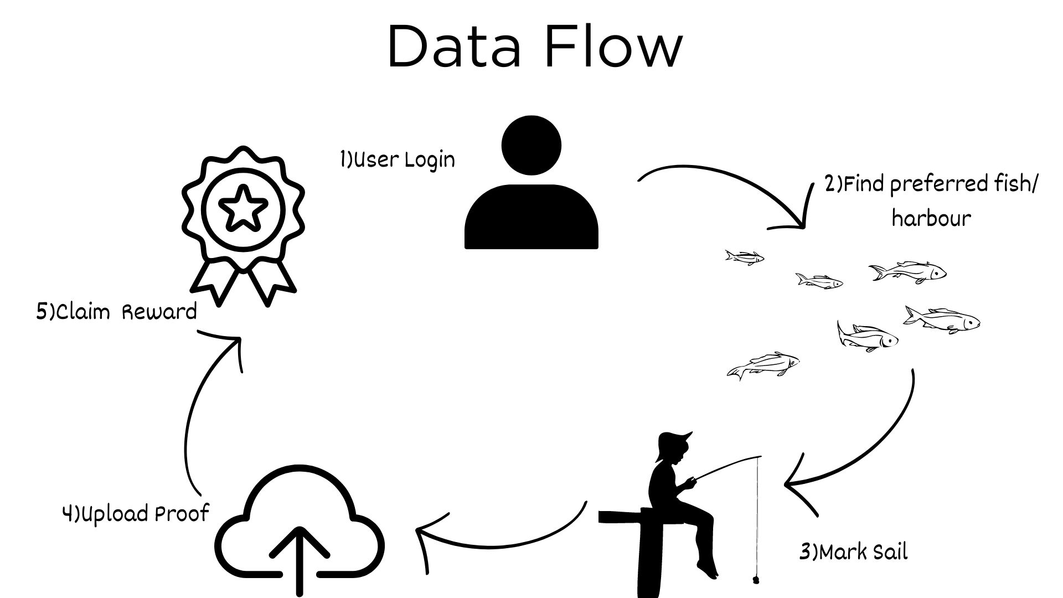
Data Flow Diagram
CHRIST
Deemed to be University
Fig 1.DFD
Fig 2.DFD(2)

Slide 11
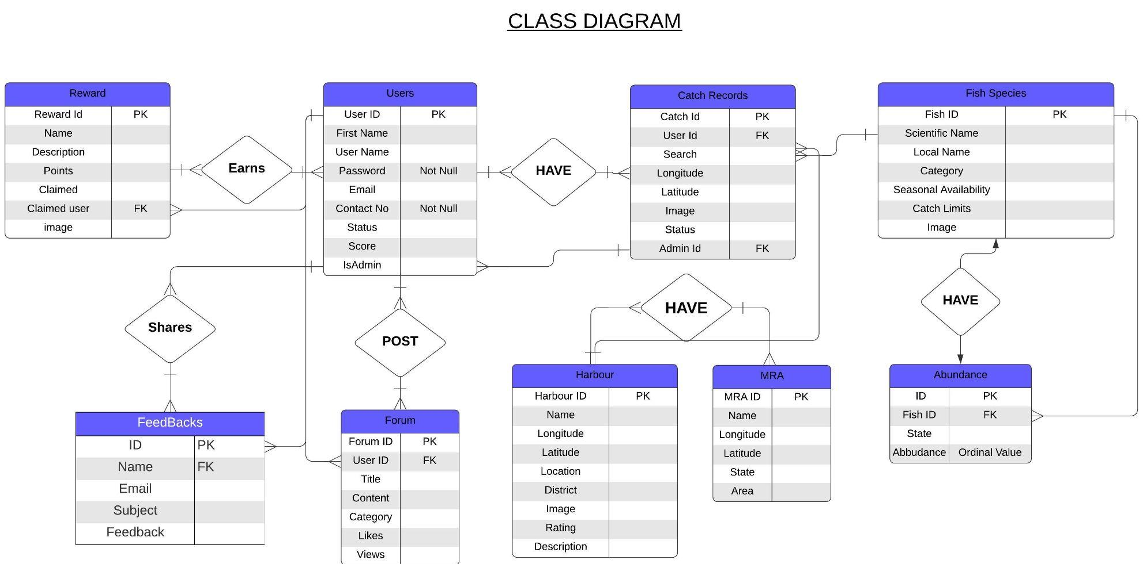
ER Diagram
CHRIST
Deemed to be University
Fig 3.ERD

Slide 12
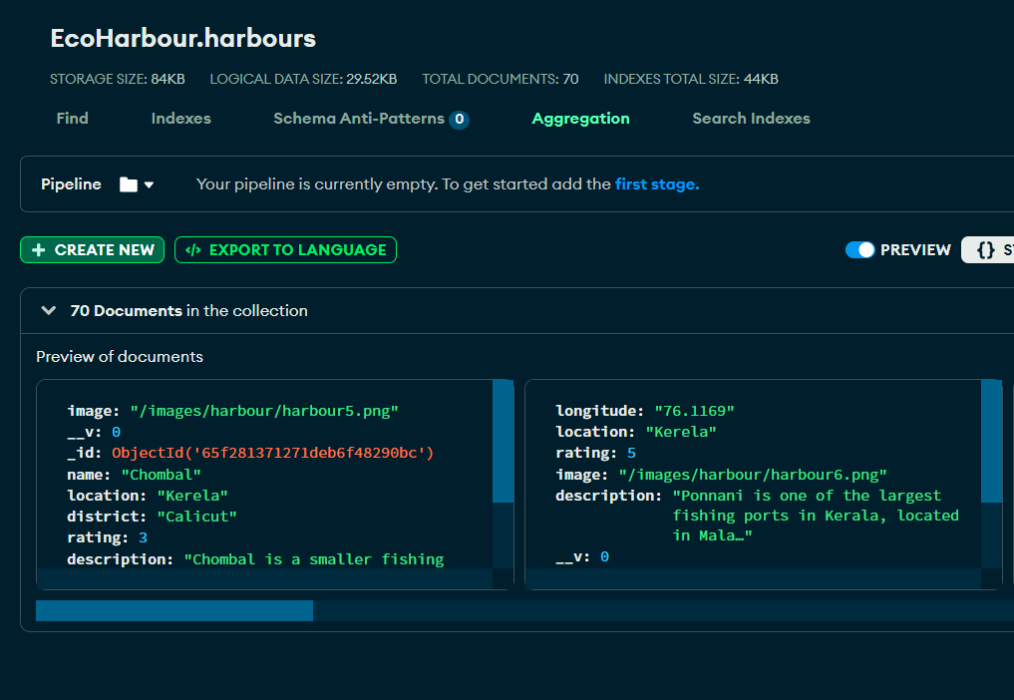
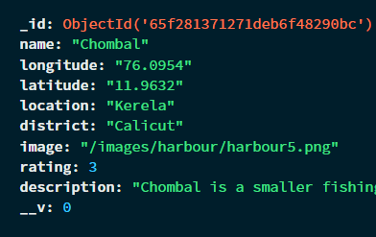
Database in MongoDB
CHRIST
Deemed to be University
Fig 4.Harbours table

Slide 13
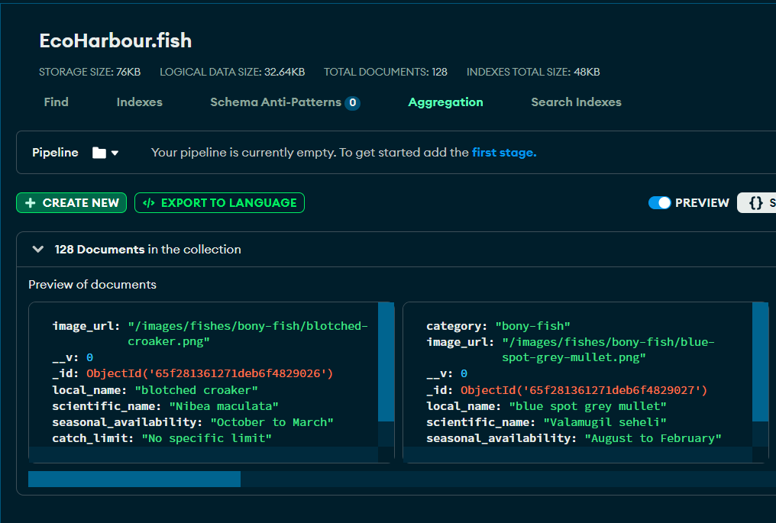
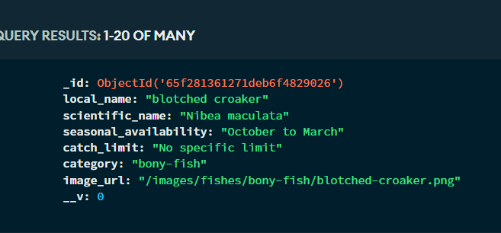
Database in MongoDB
CHRIST
Deemed to be University
Fig 5.Fish table

Slide 14
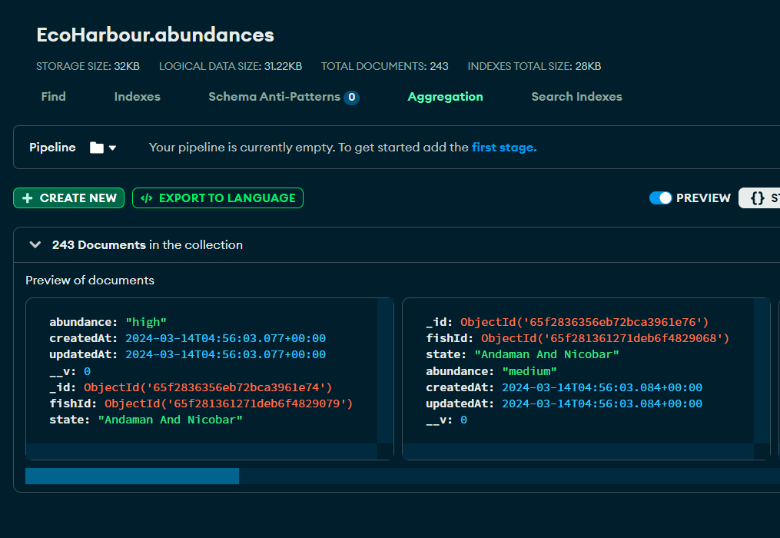
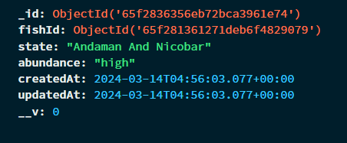
Database in MongoDB
CHRIST
Deemed to be University
Fig 6.Fish Abundance table

Slide 15
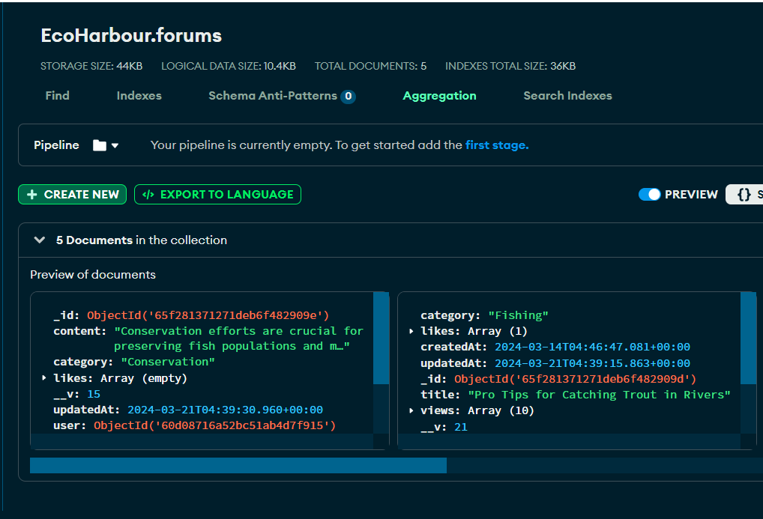
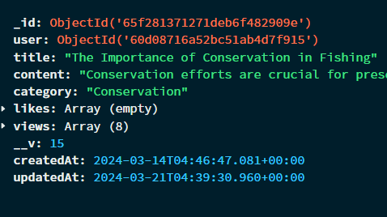
Database in MongoDB
CHRIST
Deemed to be University
Fig 7.Forum table

Slide 16
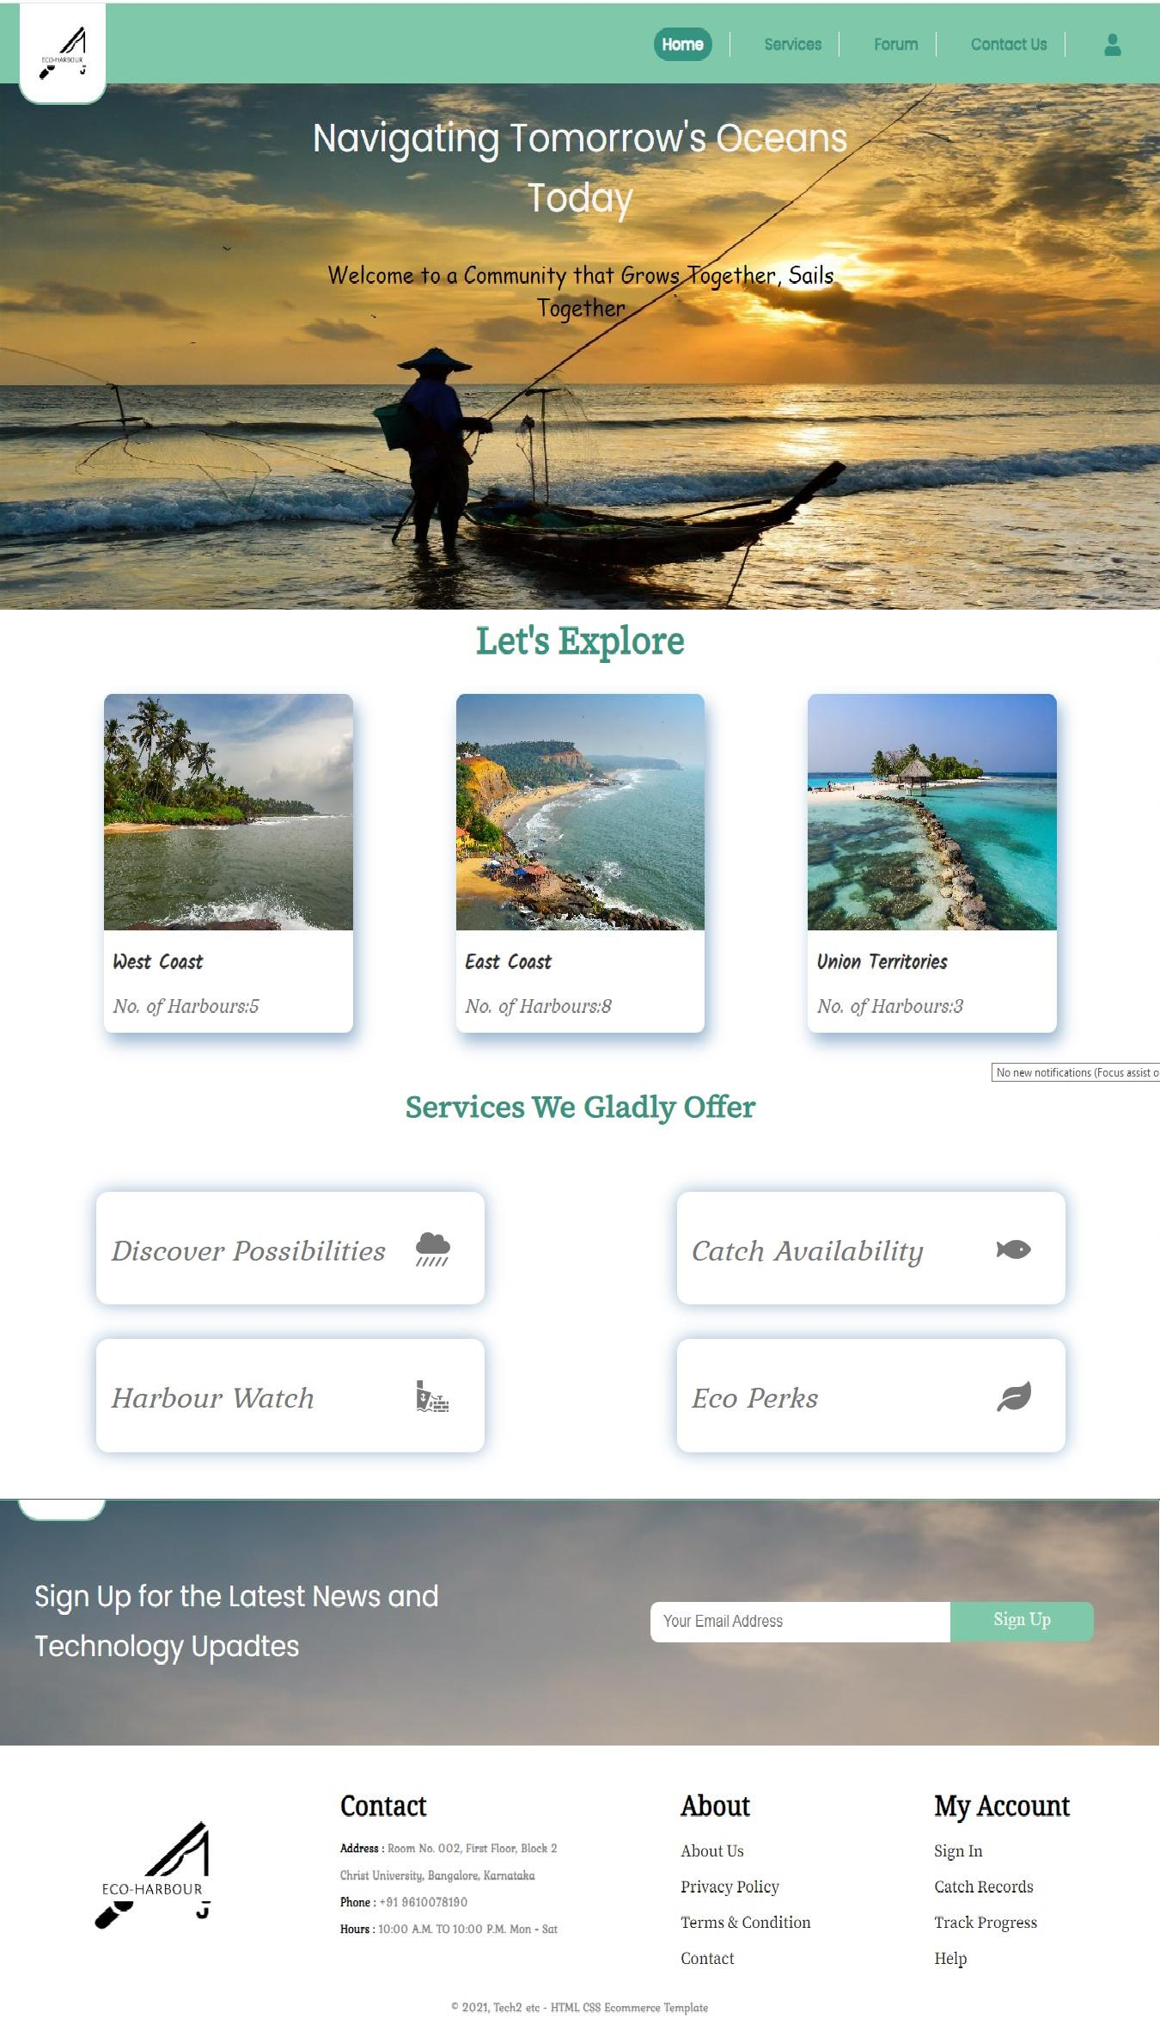
UI Design
CHRIST
Deemed to be University
Fig 8.Home Page

Slide 17
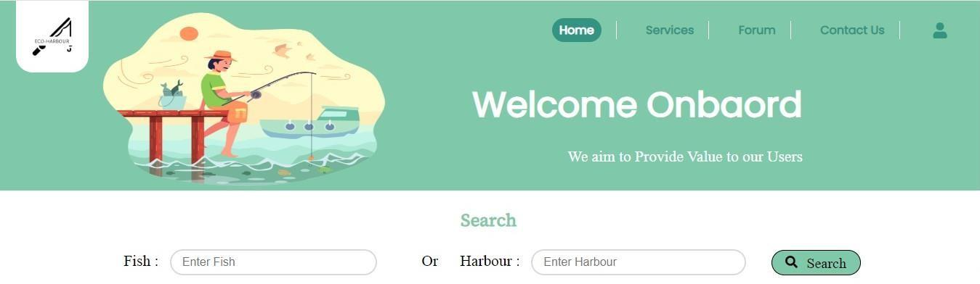
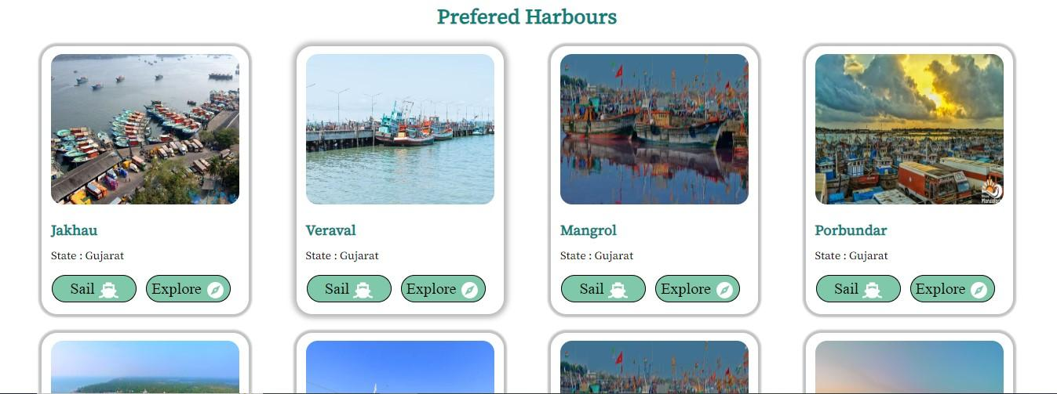
UI Design
CHRIST
Deemed to be University
Fig 9.Service Page

Slide 18
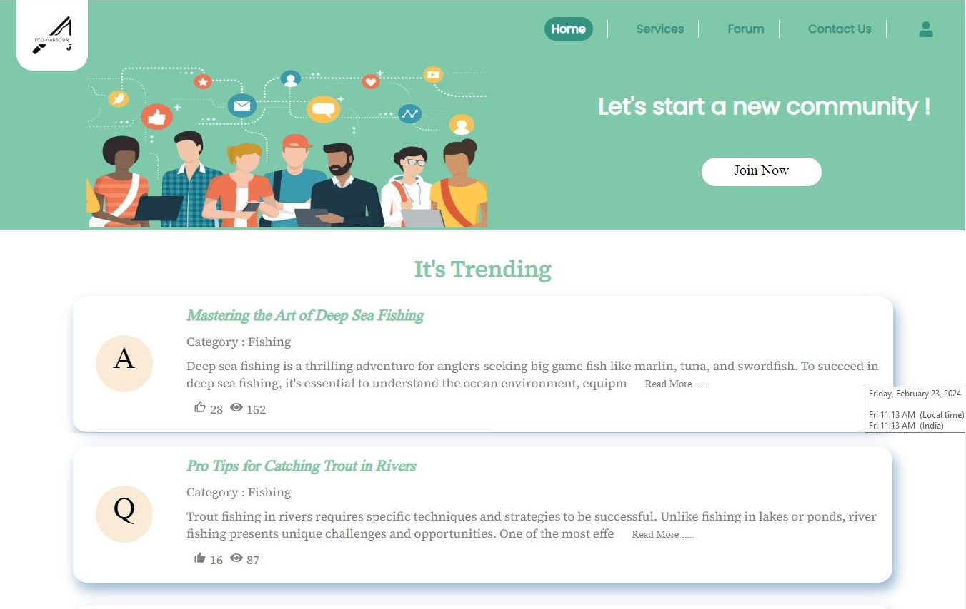
UI Design
CHRIST
Deemed to be University
Fig 10. Forum Page

Slide 19
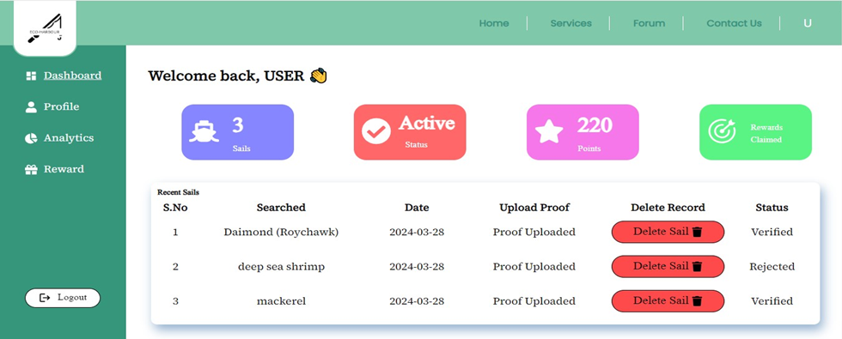
UI Design
CHRIST
Deemed to be University
Fig 11. Dashboard Page

Slide 20
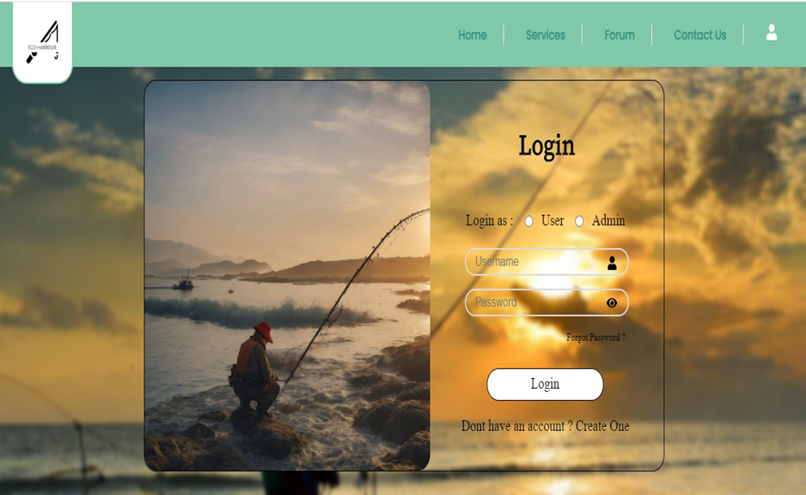
UI Design
CHRIST
Deemed to be University
Fig 12. Login Page

Slide 21
References
CHRIST
Deemed to be University
[1] MPEDA, "Major Harbours Database" Major Fishing Harbours. 3 April, 2024.
< https://mpeda.gov.in/?page_id=1007>.
[2] MPEDA, "Marine Fishing Landings" Marine Fishing Landings and boat Landings. April, 2021.
<https://mpeda.gov.in/fishers/wp-content/uploads/2021/08/006-MARINE-FISH-LANDINGS-JUNE-2021.pdf >.
[3] PIB, "Ministry of Fisheries, Animal Husbandry & Dairying" Modernising Fishing Harbours.
29 March, 2024. <https://pib.gov.in/Pressreleaseshare.aspx?PRID=1810953 >.
[4] Dr.Gopalakrishnan A., "Marine Fish Landings" Marine Fish Landings in 2023. April, 2023.
<http://eprints.cmfri.org.in/16042/1/Marine%20Fish%20Landings%20in%20India%202021.pdf >.
Excellence and Service

Slide 22
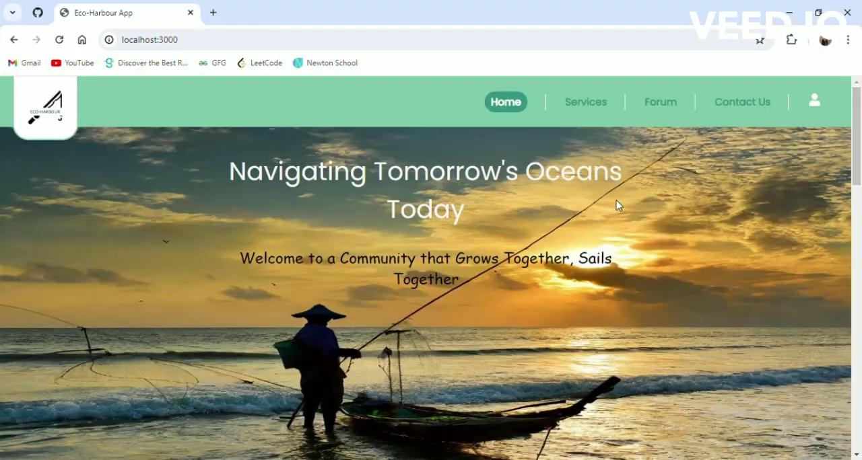
CHRIST
Deemed to be University
Excellence and Service

Slide 23
Thank You !
CHRIST
Deemed to be University

